Slide 1

MACHINE LEARNING
MEHTA MEET UTPAL
COMPUTER DEPARTMENT
BIRLA VISHVAKARMA MAHAVIDYALAYA

Slide 2
What is machine learning?
Machine learning is the science of getting computers to act without being explicitly programmed.
In the past decade, machine learning has given us self-driving cars, practical speech recognition, effective web search, and a vastly improved understanding of the human genome.
Many researchers also think it is the best way to make progress towards human-level AI.

Slide 3
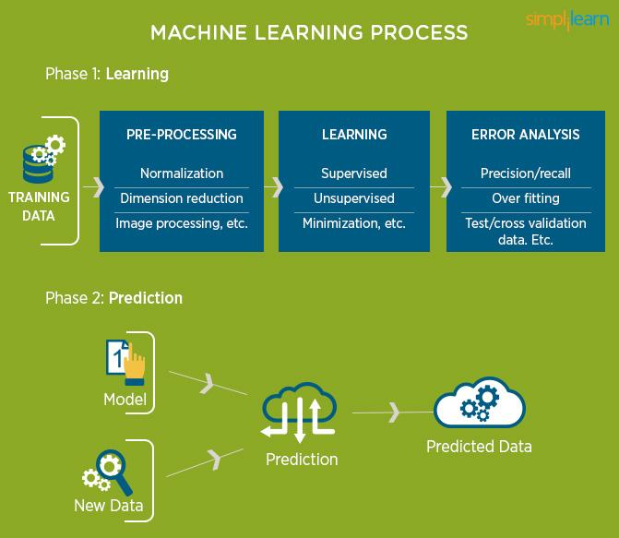

Slide 4
STARTUP IDEA!
TO CREATE A PERSONAL ASSISTANT BY MACHINE LEARNING FOR EACH AND EVERY NECESSITY AND TO CREATE AN APP WHICH HAS A COMBINE FEATURE OF WHATSAPP,LINKEDN,PAYTM et.al.

Slide 5
WHY STARTUP?
INDIA IS A COUNTRY WITH RAPID DEVELOPING TECHNOLOGY. ALEXA,BIXBY,GOOGLE ASSISTANT, SIRI et.al ARE THE ASSISTANTS WHICH ARE GOVERNING THE VIRTUAL WORLD.
BUT, THESE ASSISTANTS ARE NOT INDIAN AND THEY ARE EFFICENT AT ONLY THE LANGUAGES WHICH ARE SPOKEN COMMONLY IN THE WORLD LIKE ‘ENGLISH’,’CHINESE’,’FRENCH’,’HINDI’,’JAPANESE’.
THESE ASSITANTS HAVE OUR DATA, OUR INFORMATION: MEANS THEY UNDERSTAND US AND OUR ROUTINE AND OUR BEHAVIOUR AS TIME PASSES.
FOREIGN COMPANIES HAVE OUR DATA WITH THEM, THIS MAY NOT BE A PROBLEM TO US TODAY BUT IN A NEAR FUTURE IT CAN CAUSE A THREAT TO OUR SOCIETY AS THEY WILL HAVE OUR COMPLETE MIND BY READING AND UNDERSTANDING US.
MY STARTUP IS TO CREATE A PERSONAL ASSISTANT FOR MY COUNTRY.

Slide 6
WHY MY STARTUP IS BENEFICIAL?
DATA OF THE COUNTRY WILL REMAIN IN THE COUNTRY: PRIVACY
HUGE OPPORTUNITIES FOR SOFTWARE ENGINEERS.
MADE IN INDIA CONCEPT GETS A RAISE.
AS THE UPDATES FOR THE ASSISTANT WILL INCREASE, PRIVACY,SPEED,ACCURACY OF THE ASSISTANT WILL INCREASE.
THIS ASSISTANT WILL UNDERSTAND EACH AND EVERY LANGUAGE,SENTENCES, LOCAL PHRASES,OF INDIA: LIKE YOUR BEST FRIEND.
DIFFERENT FEATURES LIKE AUDIO CALLS,VIDEO CALLS,MESSAGES,CASHLESS TRANSACTION et.al WILL BE INCLUDED IN THE NEAR FUTURE.
AS THE ASSISTANT WILL LEARN MORE AND MORE, FOREIGN COMPANIES WOULD APPROACH INDIA FOR USING ASSISTANT:ECONOMY OF INDIA WILL INCREASE.
ONE APP CAN DO THE JOB OF 10 APPS: GREAT SAVER OF PHONE STORAGE.
ADVANCEMENT IN TECHNOLOGY IN INDIA.

Slide 7
REQUIREMENTS FOR THE STARTUP!
INVESTMENT.
DATABASE SERVERS.
TEAM OF CODERS,DATABASE MANAGERS,MARKETING TEAM.
HIGH SPEED INTERNET SERVICE.
PLACE FOR ESTABLISING THE ABOVE NECESSITIES.

Slide 8
HOW TO USE THIS APP?
THIS APP WILL FUNCTION THE SAME WAY AS WHATSAPP AND GOOGLE ASSISTANT.
YOU COULD NAME THE ASSISTANT ACCORDING TO YOUR CHOICE,AS WELL AS THE NATURE OF THE ASSISTANT: LOVING,CARING,RUDE,MATURE et.al.
IT WOULD HAVE THE SAME FEATURES LIKE GOOGLE ASSISTANT;SETTING ALARM,LOOKING FOR PLACE,WANT TO HEAR A MUSIC et.al.

Slide 9
MARKETING STRATEGY!!
ONCE THE APP IS CREATED, IT’S MARKETING IS NECESSARY, FOR PEOPLE TO KNOW ABOUT IT.
UNLIKE NORMAL WAY OF ADVERTISING;SOCIAL MEDIA PROMOTION,ENDORSING BY A SUPERSTAR, MY IDEA IS A LITTLE BIT DIFFERENT.
MY IDEA IS TO DEVELOP THE APP,AS WELL AS THE UPDATES BY THE YOUTH OF INDIA. BY KEEPING COMPETITIONS LIKE HACKETHON, A PROBLEM WILL BE GIVEN, THE PERSON WHO CAN SOLVE THE PROBLEM MOST EFFICENTLY, WILL BE THE GIVEN THE CREDIT OF CREATING NEW UPDATE FOR THE APP AND CASH PRIZE.
CONTRIBUTION WITH THE COLLEGES OF INDIA FOR PROVIDING PROJECTS FOR FINAL YEAR B.E,B.TECH.M.TECH,MCA,M.COM,B.COM et.al, WILL HELP THE STUDENT TO SOLVE A REAL LIFE CODING PROBLEM.THOSE STUDENTS WHO CAN SOLVE THE PROBLEMS EFFICENTY WOULD BE DIRECTLY SELECTED FOR THE COMPANY.
AS SOON AS THE YOUTH OF INDIA WILL START TO LEARN ABOUT THIS APP AND ITS ADVANTAGES, ITS MARKET WILL INCREASE RAPIDLY.

Slide 10
ADDITIONAL BONUS!!!
CONTRIBUTION FOR THIS APP WILL GIVE YOU REDEEM POINTS,CONVERTING THEM TO CASH; GOOD WAY TO EARN MONEY.
THE JOB IS JUST TO ALLOW THE ACCESS MICROPHONE,CAMERA OF YOUR DEVICE.
WHENEVER YOU ARE COMMUNICATING WITH ANYONE,JUST LAUNCH THIS APP, THE APP WILL LISTEN TO YOUR COVERSATION AND IMPROVISE, DEPENDING UPON THE SIZE OF THE COMMUICATION,NEW WORDS USED,NEW PHRASES USED, YOU WILL EARN REDEEM POINTS WHICH COULD BE CONVERTED TO CASH.
WE WOULD COLLABORATE WITH BHIP UPI, PAYTM,MOBIKWIK TO PROVIDE THE CUSTOMERS,CASHLESS TRANSACTION,AND EXCITING OFFERS.
THE PERSON WITH THE HIGHEST COTRIBUTION WILL GET A CASH PRIZE AND A POSITION IN THE COMPANY AS THE MACHINE LEARNING CONTRIBUTER.

